Slide 1


Towards Improved Physics-Informed Machine Learning
Ethan Shoemaker, Undergraduate Researcher
Dr. Amirhossein Arzani, Faculty Advisor

Slide 2

Introduction
Why do we need numerical methods of solving partial differential equations (PDEs)?
Traditional methods of solving PDEs
How do neural networks work?
Standard neural networks vs. physics-informed neural networks (PINN)
Advantages and disadvantages of PINN
Results of research

Slide 3
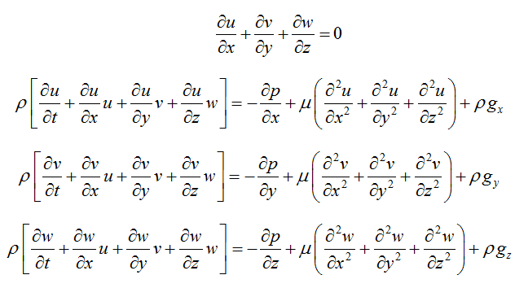
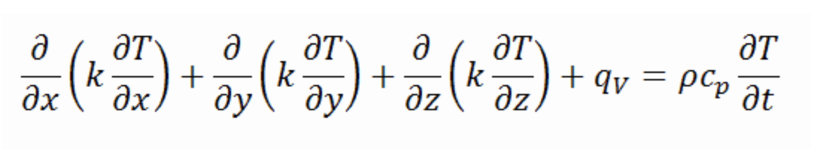
Why we need Numerical Methods of solving PDEs
Most PDEs cannot be solved analytically
  e.g. Navier-Stokes Equations, Heat Equation
Figure 2: Heat Equation
Figure 1: Navier-Stokes Equations

Slide 4
Traditional methods of solving pdes
Discretized methods
  Finite Element Method
  Finite Volume Method
  Finite Difference Method
Fourier Transform
Other mesh-free methods

Slide 5
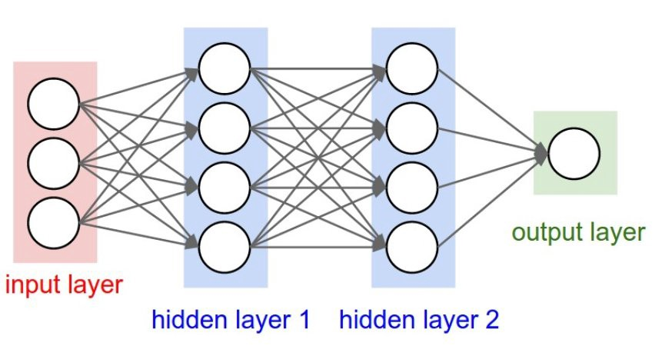
How do neural networks work?
Each “link” between neurons has an associated function
  y = Ax + b
  Non-linearity imposed on y with activation functions (e.g. swish, ReLu)
Output is checked against a dataset to train the network
The hope is that after training, the network will be able to approximate the output as a function of the input
Figure 3: Neural Network Diagram

Slide 6
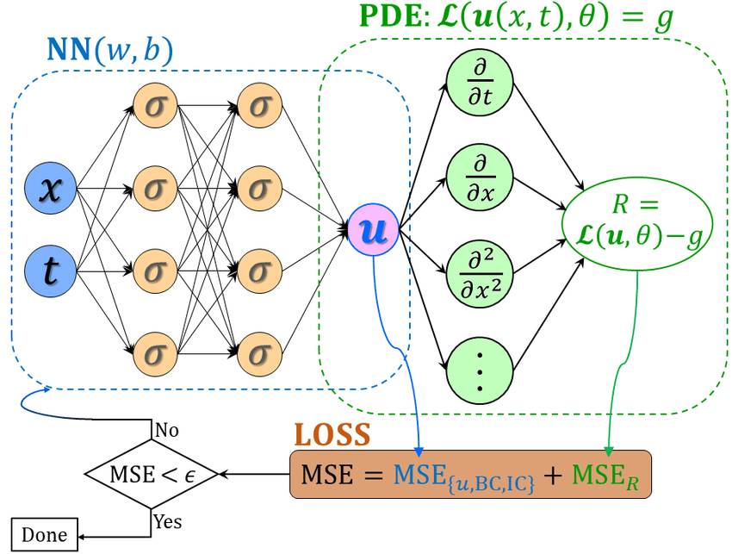
Standard neural networks vs pinn
Standard Neural Network
  Computes loss associated with training data only (purely data-driven)
PINN
  Computes loss associated with training data and the associated PDE (hybrid; data-driven and physics-driven)
Figure 4: PINN Diagram

Slide 7
Pros and cons of pinn
Pros
  Can sometimes solve PDEs without the use of boundary conditions! (uses sparse data instead)
  Easy to learn how to use
Cons
  Very slow compared to traditional methods (CFD)
  Often requires expensive computing equipment (GPUs)

Slide 8
My research
Improve the speed of a given network in solving a well-posed (known boundary conditions) problem, blood flow through a stenosis (blocked artery)
Modify the network in a manner that it can solve for fluid flow velocity field in a stenosis without the use of inlet and outlet boundary conditions (instead by using sparse pressure data)

Slide 9
Solving for velocity field without boundary conditions
Use sparse pressure data from “ground-truth” CFD simulation instead of boundary conditions (virtual experiment)
Further this network to be able to do the same thing with only 2 pressure data points similar to FFR (pressure measurement for heart disease patients) measurements taken in clinical settings

Slide 10

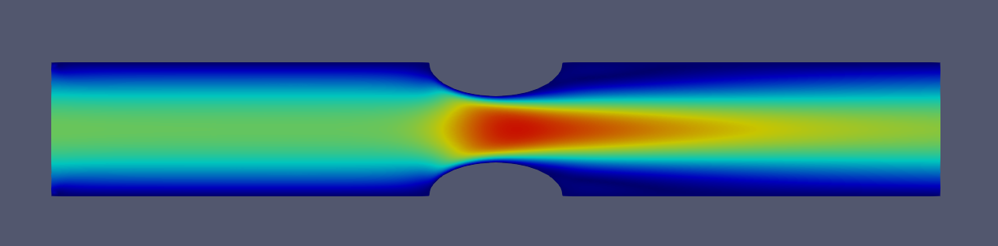


Initial results
Figure 6: CFD Pressure (Initial Pressure Sensor Locations)
Figure 7: CFD Velocity Magnitude (Ground Truth)
Figure 8: PINN Pressure Results
Figure 9: PINN Velocity Results

Slide 11

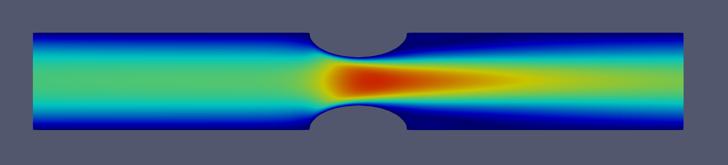
Smarter sensor locations
Figure 10: CFD Pressure (Smarter Pressure Sensor Locations)
Figure 11: CFD Velocity Magnitude (Ground Truth)
Figure 12: PINN Pressure Results
Figure 13: PINN Velocity Results

Slide 12

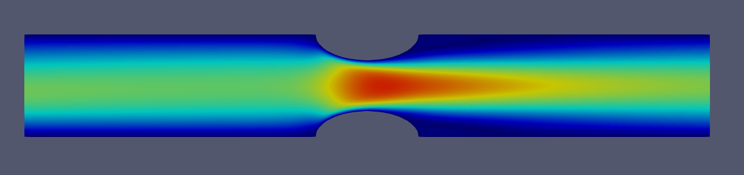
Ffr sensor locations
Figure 14: CFD Pressure (FFR Pressure Sensor Locations)
Figure 15: CFD Velocity Magnitude (Ground Truth)
Figure 16: PINN Pressure Results
Figure 17: PINN Velocity Results

Slide 13
Future work
Develop the ability to produce the same level of accuracy in 3 dimensions
Further decrease time required to converge to an accurate solution

Slide 14

Thank you
Lab Principal Investigator: Dr. Amir Arzani
Other Acknowledgments: Maryam Aliakbari
https://www.cardiolab.nau.edu

